Slide 1


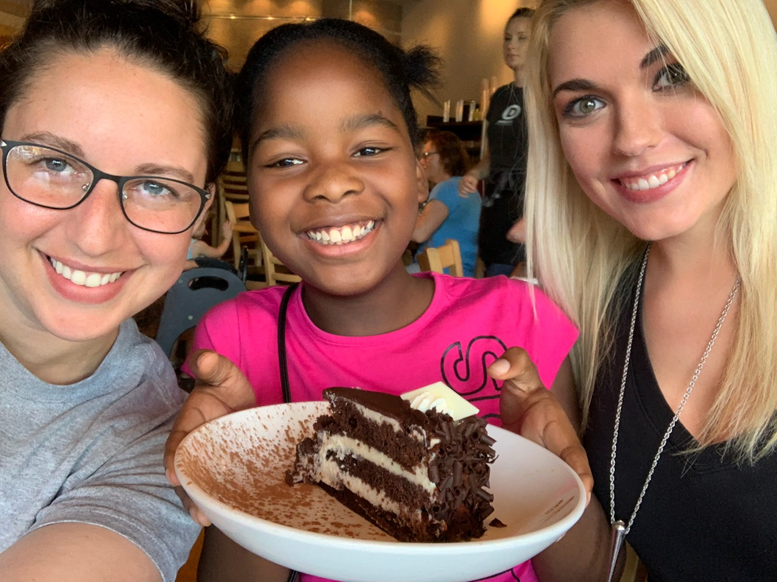
Cincinnati Youth Collaborative Urban Health Project – Summer 2019
Sarah E. S. Dennis
University of Cincinnati College of Medicine
About CYC: Cincinnati Youth Collaborative
The Cincinnati Youth Collaborative is a non-profit organization dedicated to fostering meaningful mentoring relationships between local students and adult community members. It has been shown that mentorships have significantly positive effects on the lives of disadvantaged children, including those that have experienced adverse childhood events. (Adverse childhood events include divorce, death, incarceration, etc.) These adverse events can impact a student’s success in school with the potential to cause difficulty in classes, slowed progression through grades, and ultimately decrease the likelihood of graduating.
As such, CYC was established over 30 years ago as an initiative to tackle the declining graduation rates of local Cincinnati public school attendees. Since its origin, CYC has increased graduation rates significantly—2017-2018 CYC mentees had a 94% on-time graduation rate, with 92% of mentees successfully transitioning into either postsecondary education, employment, or enlistment into the military.
Participants of the CYC Mentoring Program
Mentors: Adult persons interested in mentoring.
Mentees: Mentees range from grades 2-12 (although some mentorships can continue into adulthood).
Partners: CYC partners with the Cincinnati Public School system which allows mentors access to various resources to assist in their mentoring relationship.
Services Offered by CYC
In addition to promoting mentorships, CYC offers several work readiness and college preparation resources:
Mentoring Programs:
-One-on-One Mentoring
-Group Mentoring
-Med Mentors Program: pairs University of Cincinnati medical students with local public- school students for 1:1 or 2:1 mentorships.
Work Readiness Programs:
-High School to Career Program: a one-credit activity-based course for high school students.
Partnerships for college preparation with:
-Talent Search
-GEAR UP
-Americorps Ohio College Guide Program
My Project
Future Direction
For further analysis on the cultural competency survey data, we have partnered with the Biostatistics, Epidemiology, and Research Design (BERD) division of the Center for Clinical and Translational Science and Training (CCTST).
Reaching Out
CYC relies on volunteer mentors with a passion for helping local students, both within and outside of their school environment, and are wholly dedicated to empowering their mentees to achieve success. If you are interested in volunteering or want more information, visit www.cycyouth.org.
Mission Statement: “CYC empowers vulnerable children and young adults to overcome obstacles and succeed in education, career, and life.”
-Cincinnati Youth Collaborative
Impact
I joined the CYC organization as a Med Mentor in 2018, which was an experience that gave me the initial exposure to CYC’s goals and values and inspired me to further my involvement with them as their summer intern. This internship gave me the opportunity to learn more about the local residents that I hope to serve as a future physician and made me, an out-of-state resident, feel more at home in this community. I look forward to continuing my involvement with CYC and the Med Mentors program in the future.
Overview
During the summer season of 2019, I was brought onto the CYC team as an intern and was tasked with various responsibilities. My primary objective was to analyze a set of pooled data for the CYC Med Mentors Program. Another main facet of my project was to create two informational workshops that discussed the college application process and employability skills. These 1-hour interactive workshops were given once during the summer season. Each session was attended by several local high school and college-age students that were participants of a Cincinnati summer youth employment program.
Cultural Competency: Data Analysis
This aspect of the project was dedicated to analyzing the pooled data sets from previous years of Med Mentors surveys. Over the last 5 years (2014-2019), participants of the Med Mentors Program (all University of Cincinnati medical students) were administered two surveys that assessed their knowledge, skill, and comfort levels regarding several culturally-driven situations to determine an individual’s overall cultural competency. The first survey (denoted the “pre-survey”) was taken by mentors upon entrance into the program; the second survey (referred to as the “post-survey”, which was identical to the first) was administered after one year of mentoring. The mentor responses were then extracted and organized into an Excel document, which is updated annually with new Med Mentor data.
Methods
The Med Mentors Cultural Competency Pre- and Post-Surveys consisted of approximately 30 scenario-based questions (encompassed under three categories: knowledge, skill, and comfort). Participants denoted their perceived knowledge, skill level, and/or comfort level to the culturally-based scenarios with one of five options: “not at all”, “a little”, “somewhat”, “quite a bit”, or “very”. Individual Med Mentor responses to the pre- and post-surveys of participants that entered the program between 2014-2019 were de-identified and pooled into separate data sets (organized by pre- vs. post-data) into an Excel document. Data was sorted and paired; all other data was excluded (the exclusion criteria for the data included: repeated data, entries with incomplete survey responses, and unpaired survey responses). The participant responses were assigned a numerical value (0 = “not at all”, 1 = “a little”, and so forth). The numerical values of each response for each individual were added and the sum averaged to obtain the results below, which compares the mean of the pre-survey to the post-survey.
Results
Analysis shows that there is a difference in the overall cultural competency of Med Mentor participants from when they enter the program to after one year of mentoring (graphed below).
Acknowledgements
I would like to thank Antione Spriggs of CYC and Dr. Charles Cavallo for their guidance and assistance with this project. Additionally, I would like to thank the CCTST and BERD for their help in moving the Med Mentors data analysis portion of this project forward. Thanks to all the CYC staff, Namratha, and Isaiah for their support.
References
https://www.cdc.gov/violenceprevention/childabuseandneglect/acestudy/aboutace.html
https://www.cycyouth.org
CYC Core Values:
Passion, Integrity, Accountability, Empowerment, Community

